Slide 1
Series / Parallel Circuit
Current=X
Current=Y
+
BATTERY
Current=X
-
Current=Y/2
Current=Y/2
Current=X
Current=Y
Series
Parallel

Slide 2
Conducting or Non-Conducting Material
LED
+
BATTERY
-

Slide 3

Nuclear Fission
Chain Reaction

Slide 4
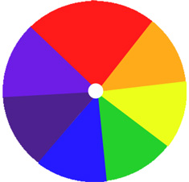
Newton's Color Disk

Slide 5

Potentiometer – a variable resistor with dual LEDs
BATTERY
+
-

Slide 6
Switches in Series combination
BATTERY
+
-

Slide 7
Switches in Parallel combination
BATTERY
+
-

Slide 8
Capacitors
BATTERY
+
-

Slide 9
Capacitors in Series combination
BATTERY
+
-

Slide 10
Capacitors in Parallel combination
BATTERY
+
-

Slide 11
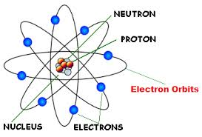
Rutherford atomic model

Slide 12
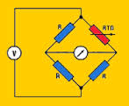
Wheatstone Bridge

Slide 13
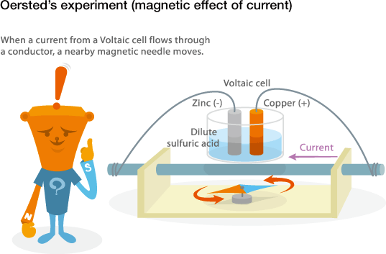

Slide 14
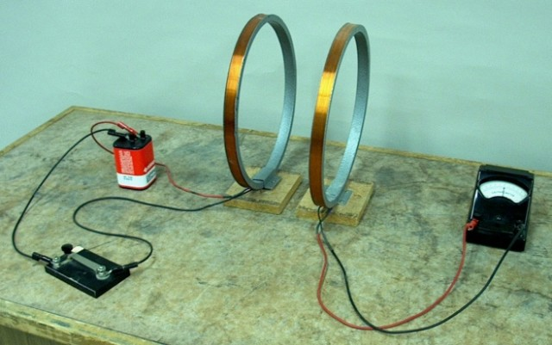

Slide 15
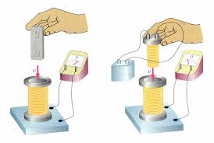

Slide 16
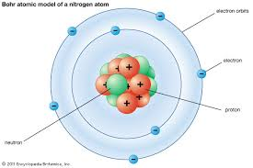

Slide 17
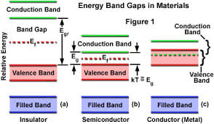

Slide 18
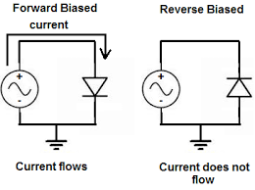

Slide 19
